Slide 1
-0.993421052631561 308
year | ck
2000 | A

Slide 2
Penguin identification number : -0.993421052631561 308
Information about Marie Vaugoyeau
Graphique Life Cycle Saving
Graph associated with the penguin -0.993421052631561 308
Contact information

Slide 3
Click back to the menu

Slide 4
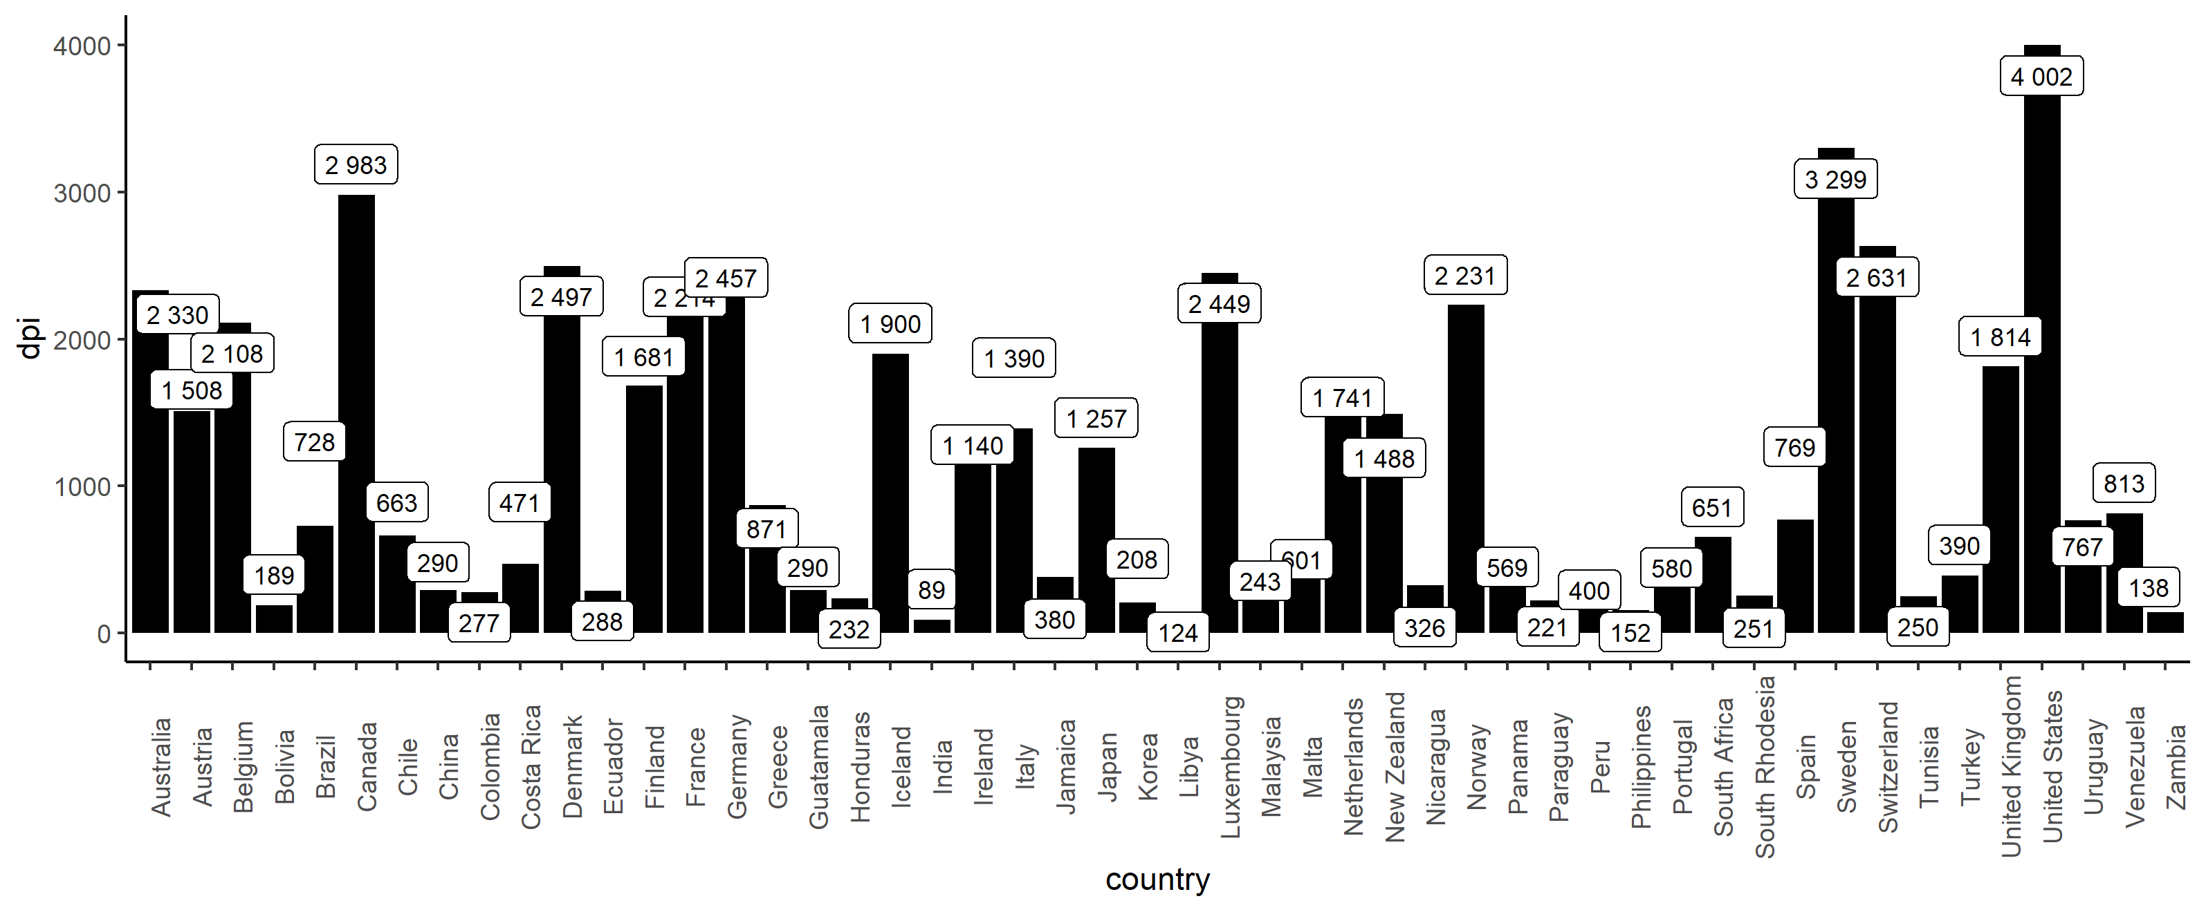
Graph LCS
Click back to the menu

Slide 5
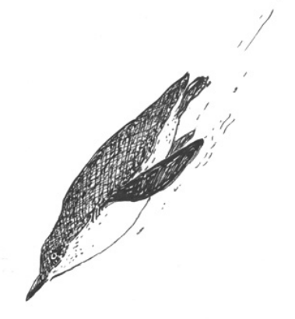
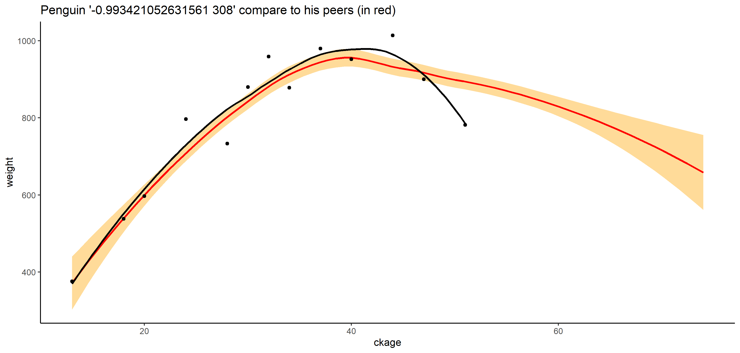
Penguin graph
2000 A
Click back to the menu

Slide 6
Click back to the menu

